Slide 1



Music Machine Learning
VII – Gaussian Mixture Models
Master ATIAM - Informatique
Philippe Esling (esling@ircam.fr)
Maître de conférences – UPMC
Equipe représentations musicales (IRCAM, Paris)

Slide 2
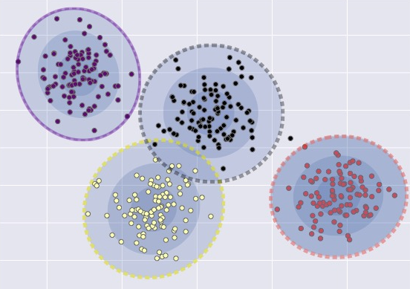

Probabilistic interpretation of clustering
In the previous course, we defined probabilistic clustering
Relying on one Gaussian distribution per cluster
So we have each of the
However, we saw the full density $p\left(x\right)$ is multi-modal
Each mode represents a sub-population
Unimodal Gaussian for each group
Mixing coefficients
Unimodal

Slide 3
Mixture models
We have seen in Bayesian inference how to deal with
Now we have a more complicated mixture distribution
Mixing coefficients
So the full distribution is defined as

Slide 4
Gaussian Mixture Model (GMM)
The full distribution is a Gaussian Mixture Model (GMM)
Generally speaking, mixture models are defined as sums of distributions
Components of a mixture model
Base distribution (here Gaussian)
Mixing probabilities (here memberships)
Note this implies constraints
Optimizing this model implies a complicated problem

Slide 5
Optimizing GMM
As we have seen previously, we have a latent variable
This defines mixing probabilities, with then
Therefore, we can retrieve our model by marginalization
If we knew the latent , optimization is easy as
However, we need to optimize both and
Goal of the Expectation-Maximization algorithm

Slide 6
Expectation-Maximization
EM tries to tackle this by maximizing the full likelihood
The complete likelihood is
Start from a random initial guess
Then iteratively apply (until convergence)
E-step: compute the expectation of the likelihood
This function is called the Q-function
M-step: compute by maximizing the Q-function

Slide 7
Expectation-Maximization
In the previous course, we have derived these generic expressions using approximations, leading to
Optimizing the lower bound with respect to
KL-divergence is non-negative, and equals to zero when
Note: the calculation of is based on current
Therefore our optimal solution is simply
Next, we can optimize the parameters in the M-Step
So how to apply this in practice for GMM ?

Slide 8
E-Step for GMM
Thanks to derivation, we have the optimal approximation
So we simply need to compute the latent probabilities
Noting that we need to satisfy the constraint
Therefore, we can directly use the definition
Then, we can simply normalize with

Slide 9
M-Step for GMM
Based on our estimate (E-Step) of the latent
The M-step seeks to optimize the parameters as
Here, we provide the example for the univariate case
Writing down the full density produces
Solving the derivative of one parameter to be zero
So we have
Similar derivations for all parameters and multivariate case

Slide 10
Mixture density estimates
GMMs are useful for density estimation
Consider the following distribution
Example of spectral harmonics
Clearly not a single Gaussian
Mixture density estimates
Allows to directly target
Provides a generative model on our data
Problem of number of components
k=2
k=5
k=16

